Slide 1
No More Singing the Homework Blues
School Library Resources Available 24/7 with TexQuest
Ann Vyoral
Educational Specialist, Digital Resources & Library Services
Education Service Center, Region 20
Ann.Vyoral@esc20.net

Slide 2
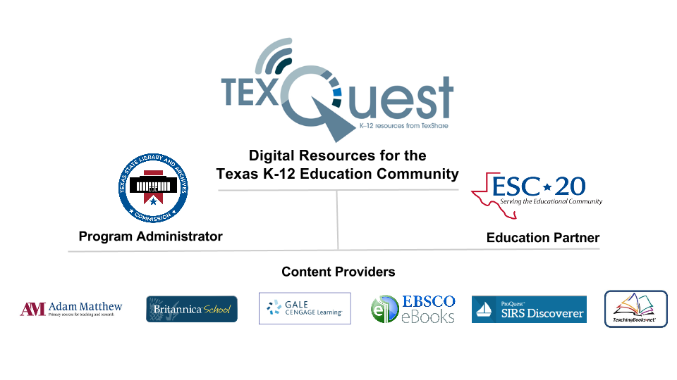
What Is TexQuest?
Notes:
TexQuest is a resource sharing program, administered by the Texas State Library and Archives Commission, for Texas K- 12 public school and open enrollment private school communities.

Slide 3
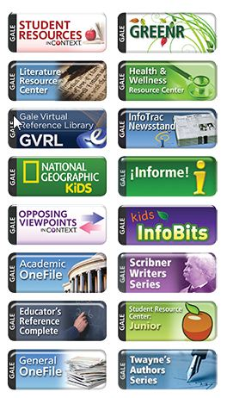
What’s in Gale?
Magazine Articles
Newspaper Articles
Excerpts from Reference Books
E-books
Full text Magazines
News Clips
Videos
Audio Files
Images
Grouped in databases by content level

Slide 4
What’s in Adam Matthew Digital?
Digitized Reproductions of Historical:
Photographs
Journals & Diaries
Books
Maps
Broadsides
Drawings

Slide 5
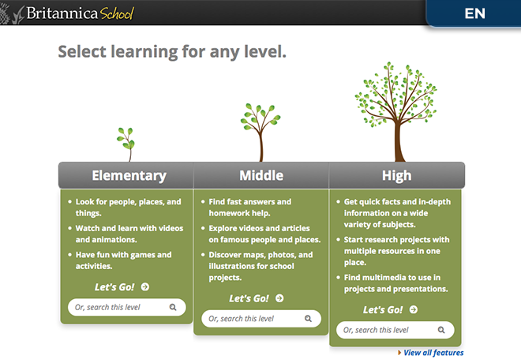
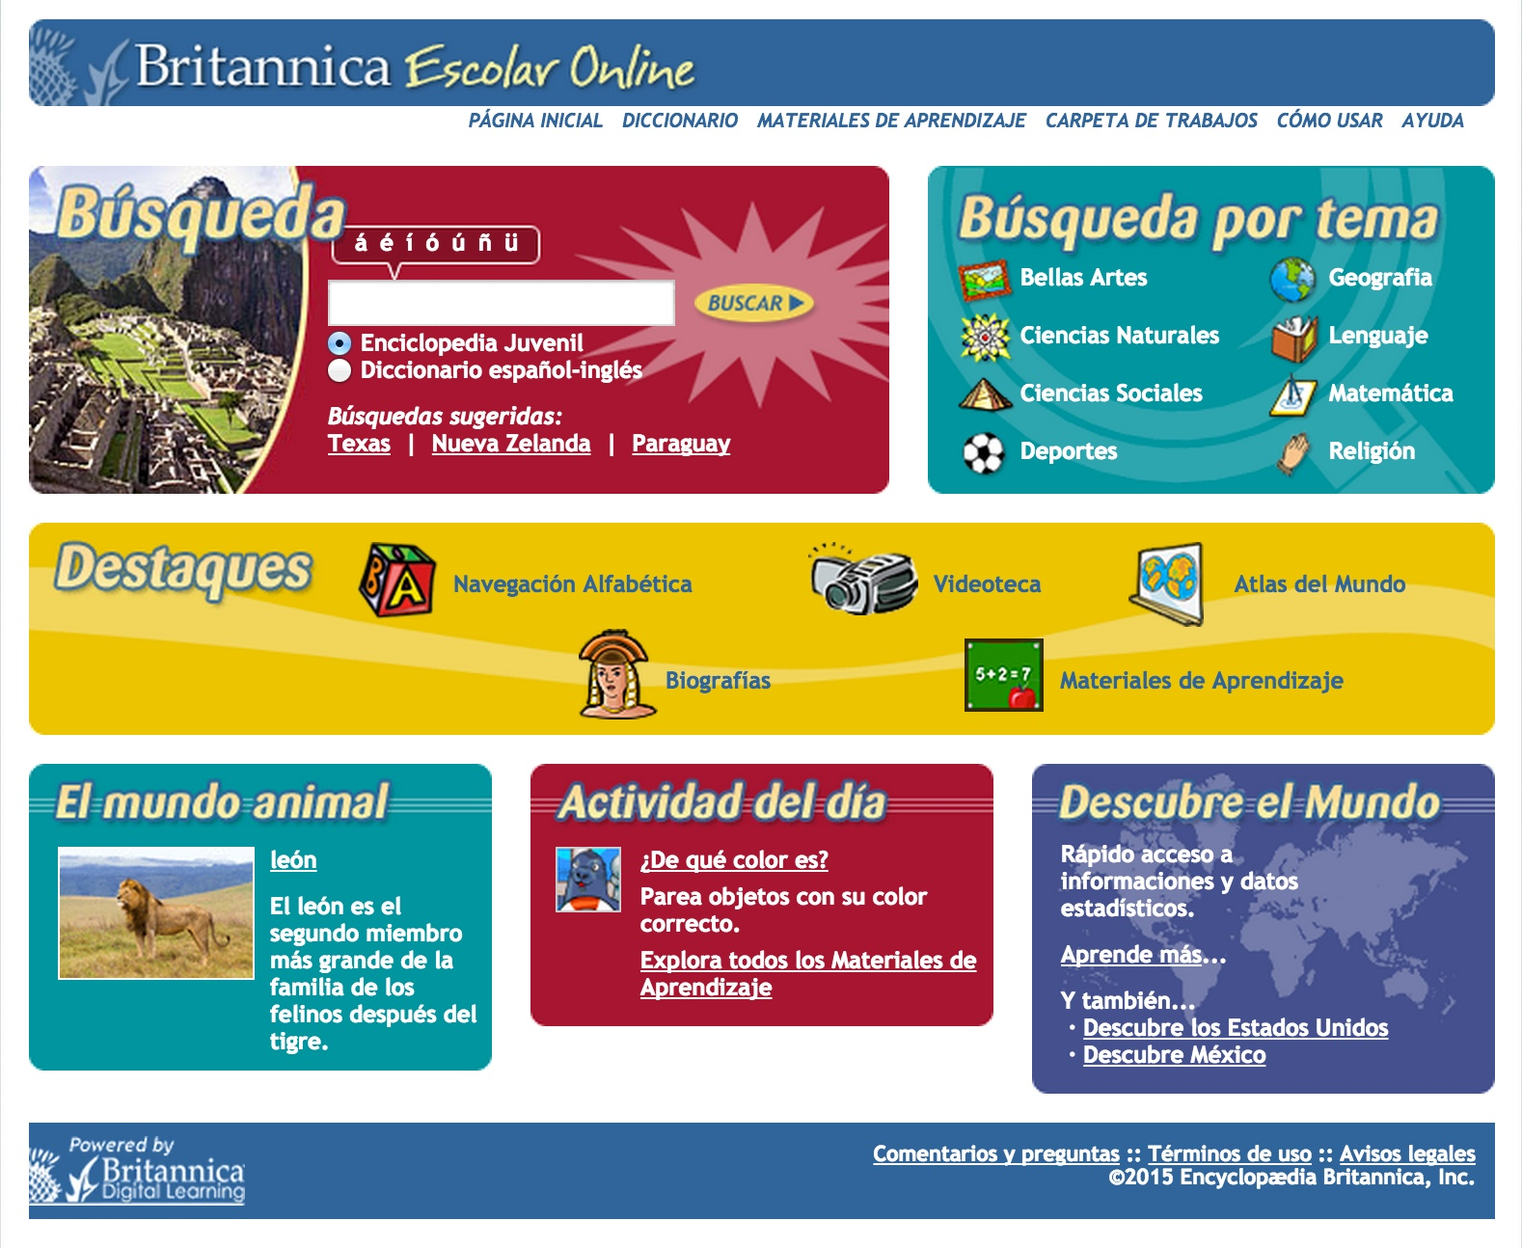
What is in Britannica Schools?
Britannica School - 3 Levels
2 Levels Spanish Encyclopedia

Slide 6
Which eBooks are included in EBSCO?

Slide 7
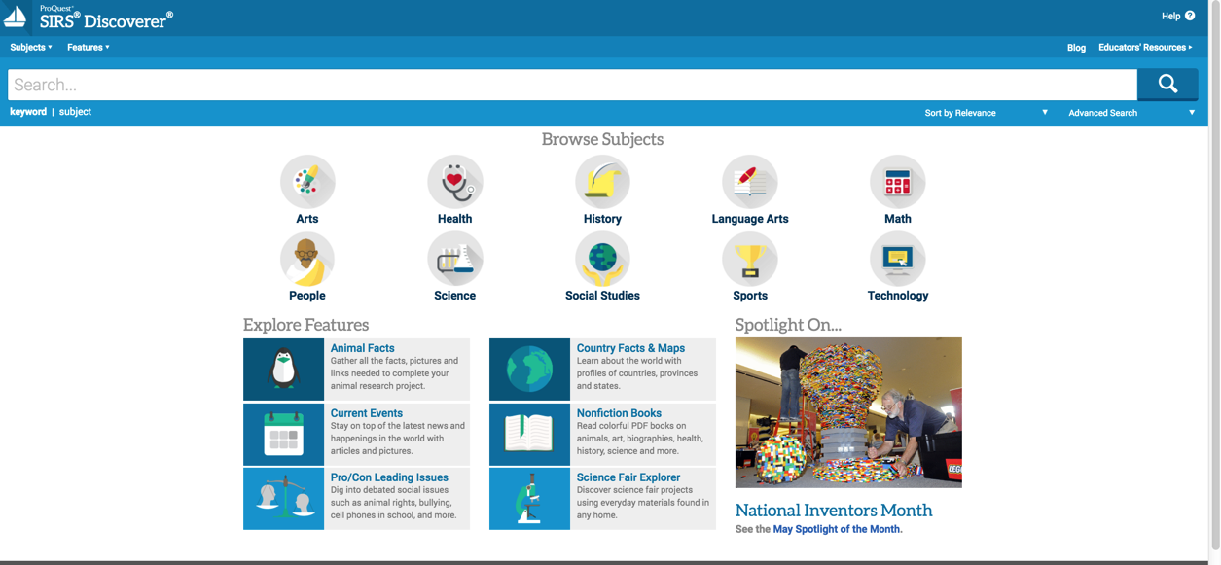
What is in SIRS Discoverer?
ProQuest SIRS Discoverer: K-8 General Content, Web Links, eBooks

Slide 8
What is Teaching Books.net?
Meet-the-Author Movies & Book Readings
Author Name Pronunciation Recordings
Instructional Materials: Lesson Plans, Vocabulary Lists
Booklists, Customizable Reading Lists
Sharing Tools: QR Codes, Bookmarks
And much more…..

Slide 9
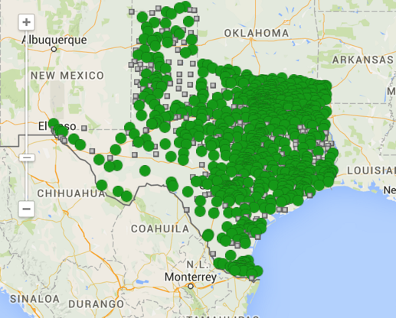
Has my child’s school signed up?
Check out the map on TexQuest.net
Contact TexQuest Support Center at texquest@esc20.info

Slide 10
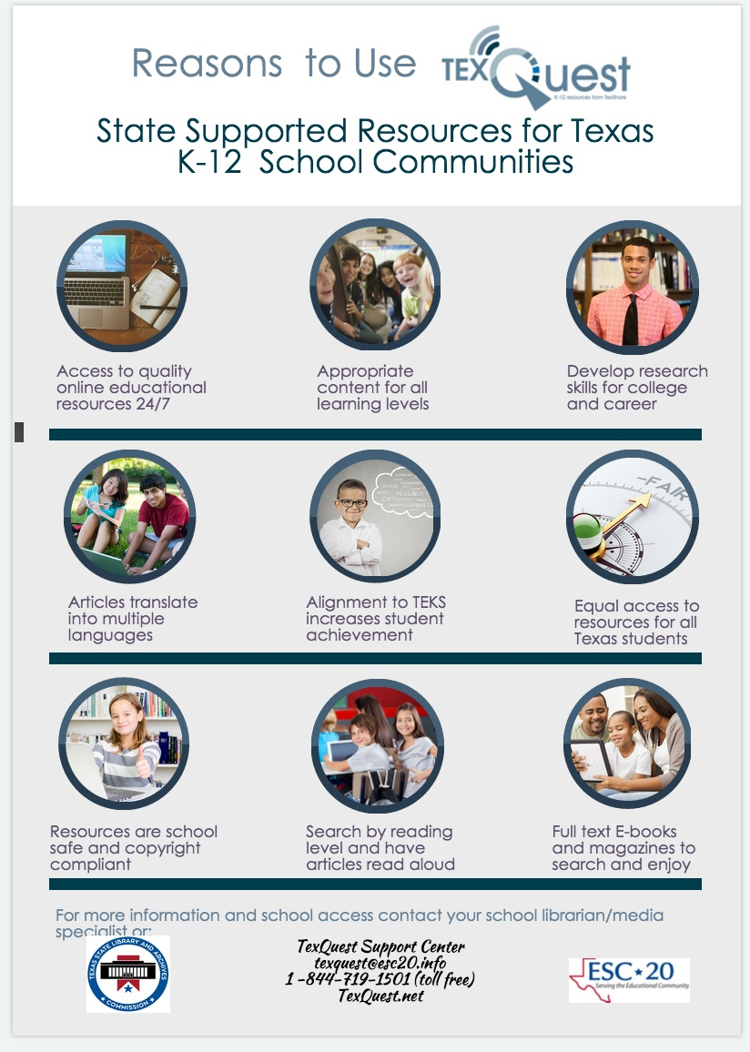
Why Should We Use TexQuest?

Slide 11
How can we access TexQuest from home?
Get your district/school username/password
From your school librarian
Contact TexQuest Support Center at
texquest@esc20.info

Slide 12
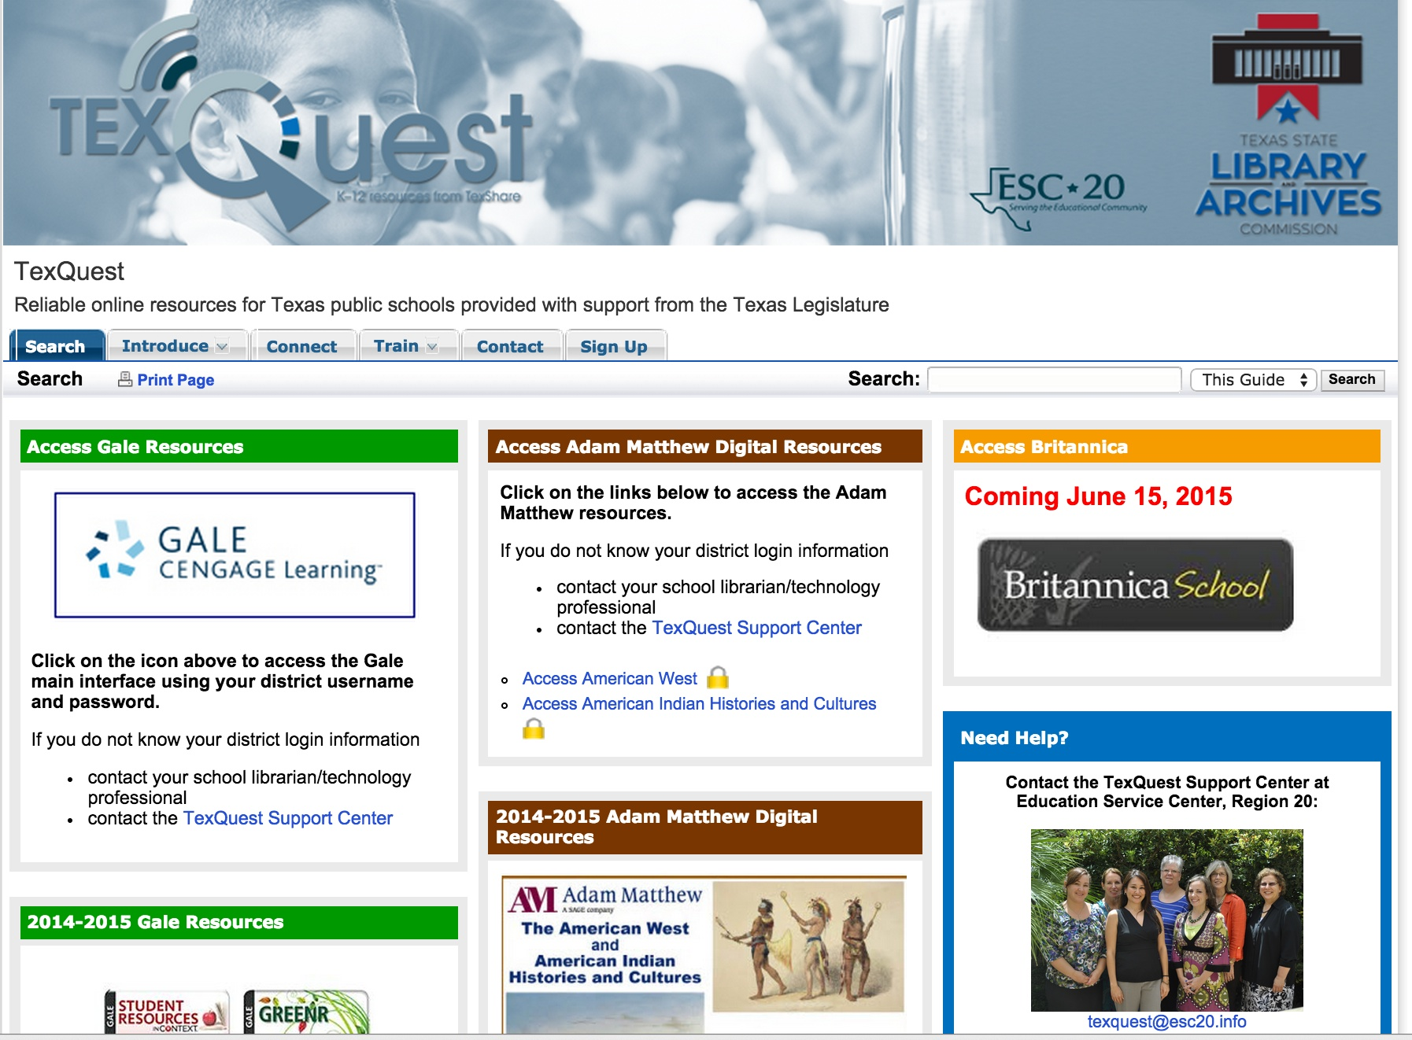
How can we access TexQuest from home?
Go to TexQuest.net

Slide 13
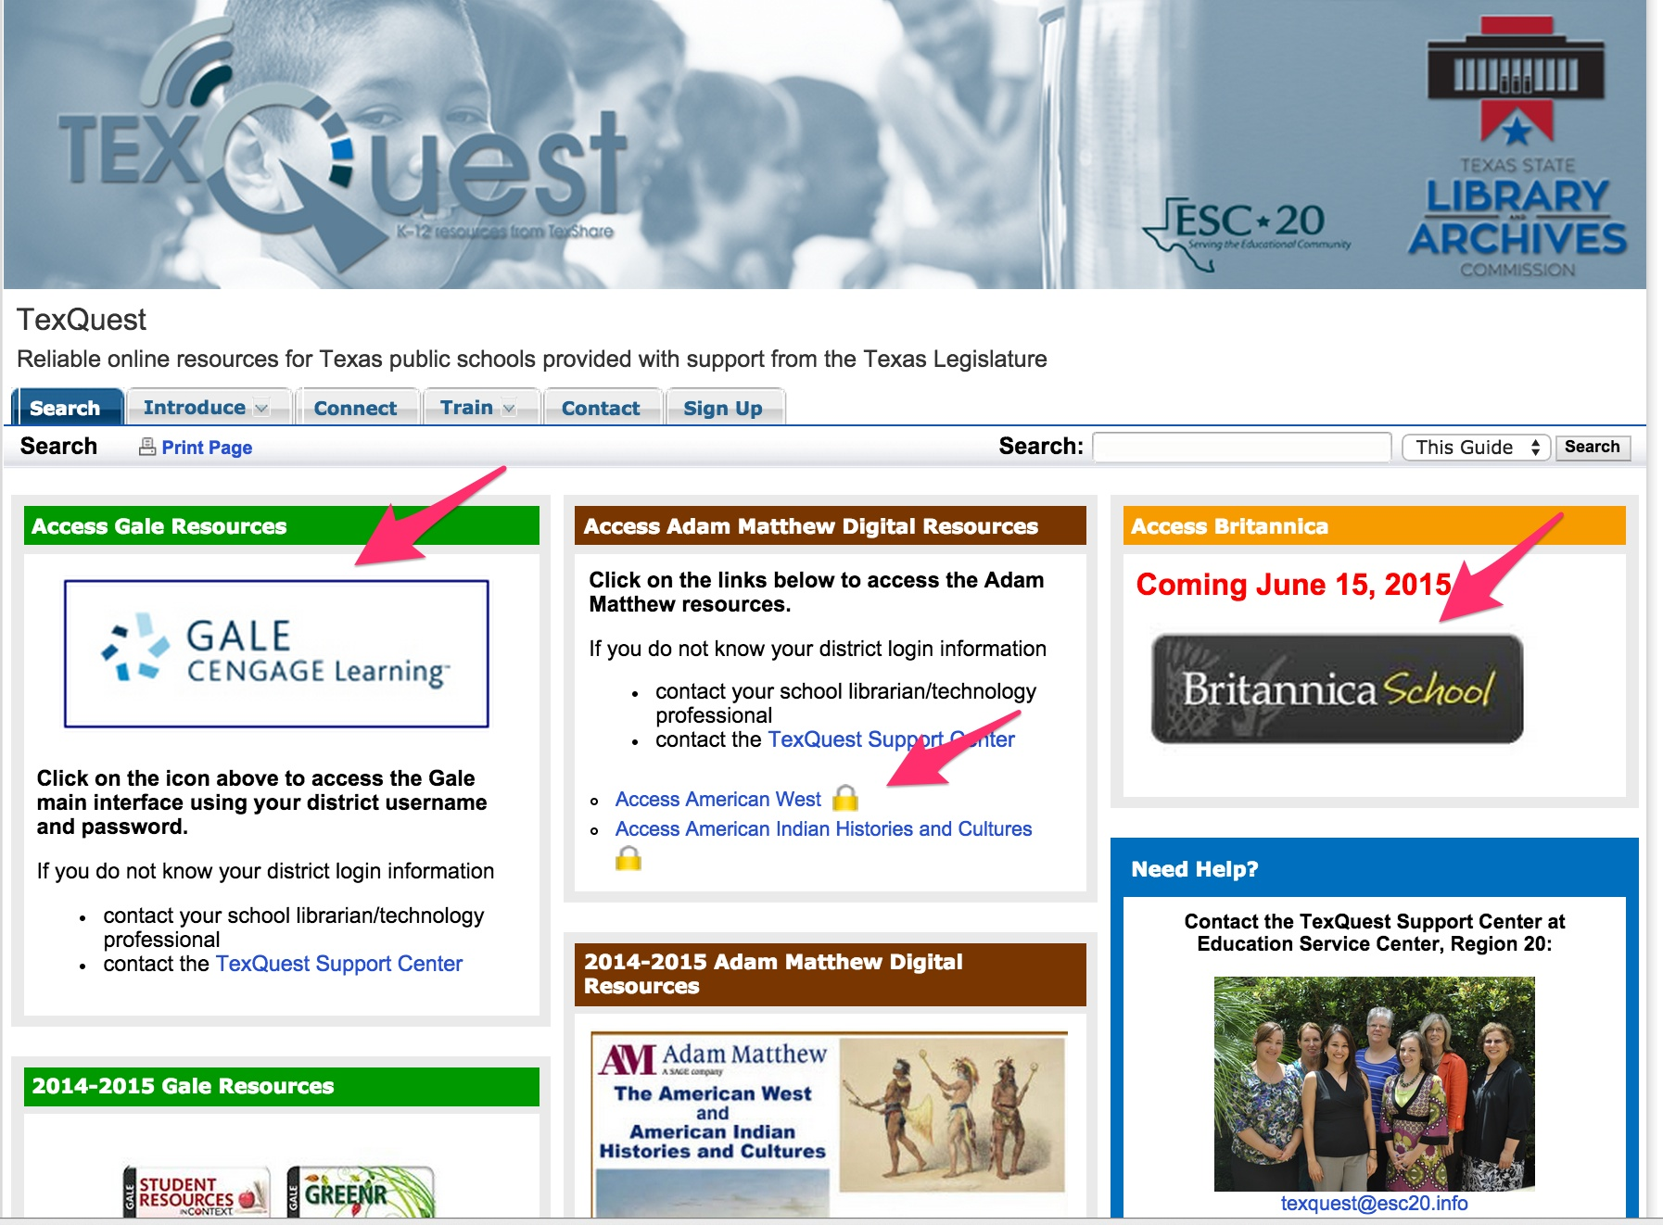
How can we access TexQuest from home?
Select the icon or url for the resource you want

Slide 14
How can we access TexQuest from home?
4. Type in username and password

Slide 15
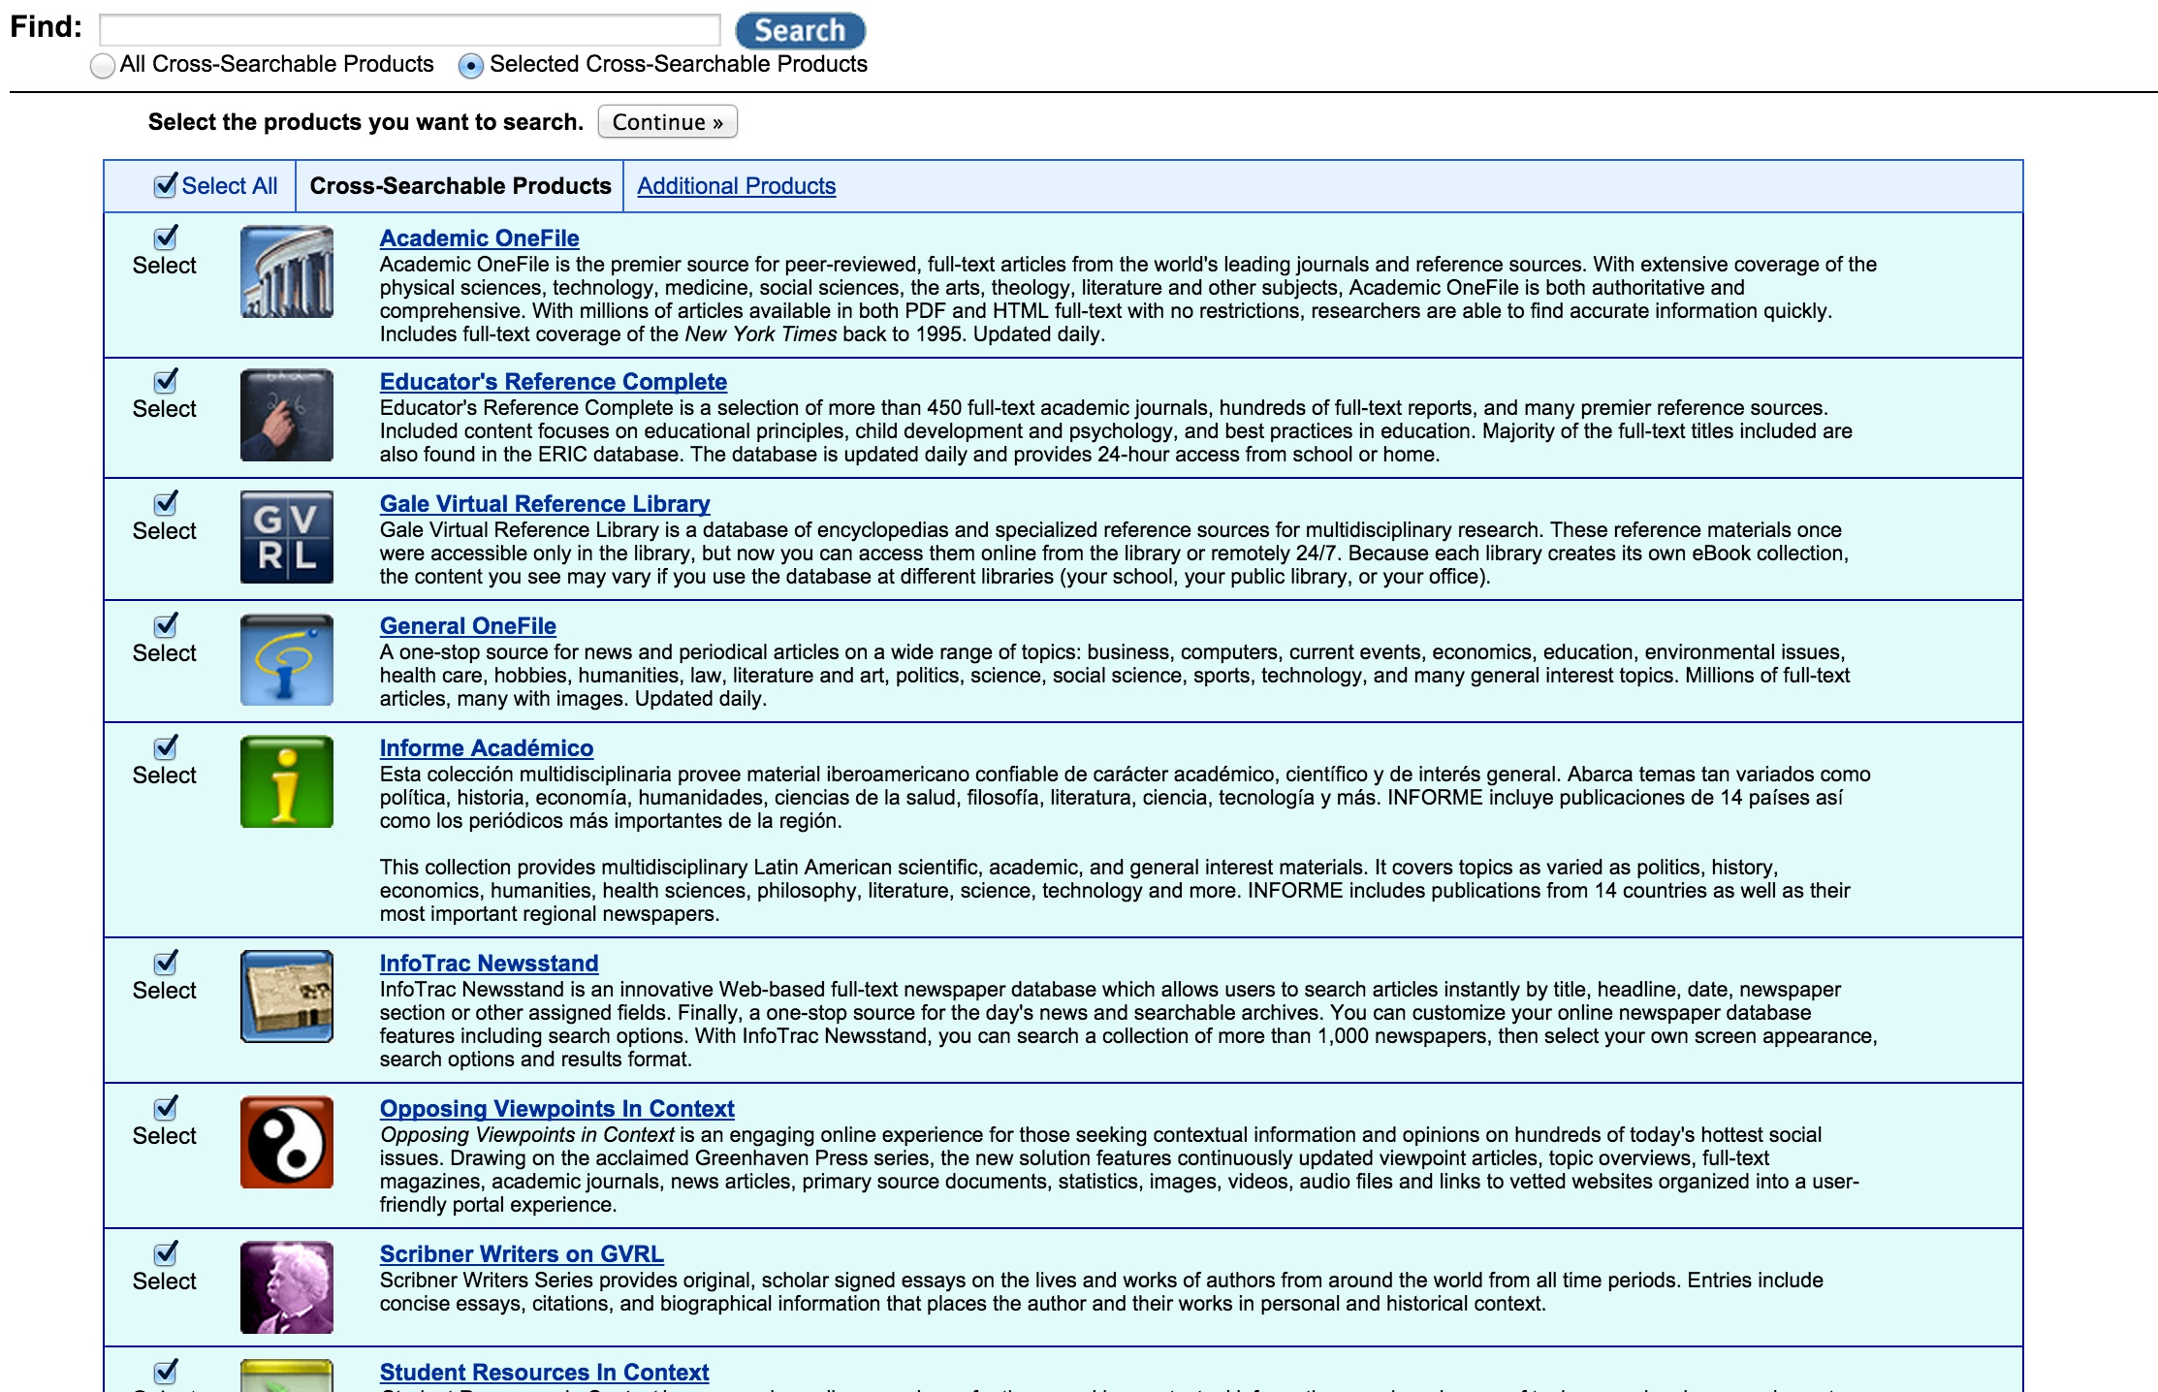
How can we access TexQuest from home?
Select your resource

Slide 16
10 Reasons Why
Your Child Needs At Home

Slide 17
stay
INVOLVED
Notes:
TexQuest is available anytime anywhere for school and home use as long as there is Internet access. Licenses purchased by the Texas State Library and Archives Commission on behalf of all Texas K-12 public school and open enrollment charters school communities include educators, students, and students’ immediate families. With TexQuest, parents can be more involved in their children’s education, especially homework, school projects, and their children’s personal interests.

Slide 18
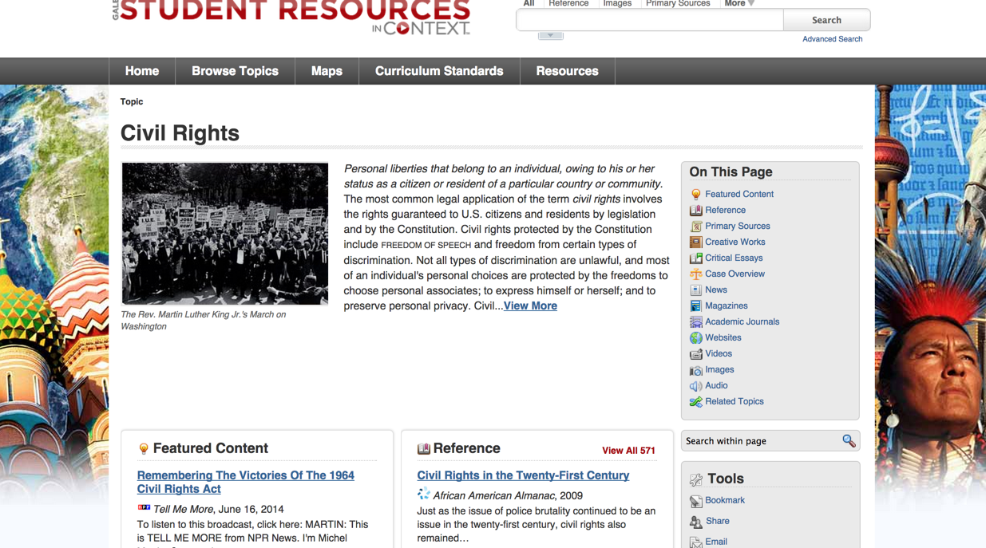
Help Your Child Find Multiple Resource

Slide 19
resources for
ALL students
Notes:
Parents can easily identify content most suitable for their child, whether he or she has special needs or is in the gifted and talented program.
TexQuest includes age-appropriate resources for elementary, middle, and high school students. Content can be searched by reading level, text can be enlarged, and most resources have read-aloud features which can be streamed or downloaded. In addition, most TexQuest resources can be translated into multiple languages other than English, and many translations have the read-aloud feature. Some TexQuest partners also offer resources that originate in Spanish.

Slide 20
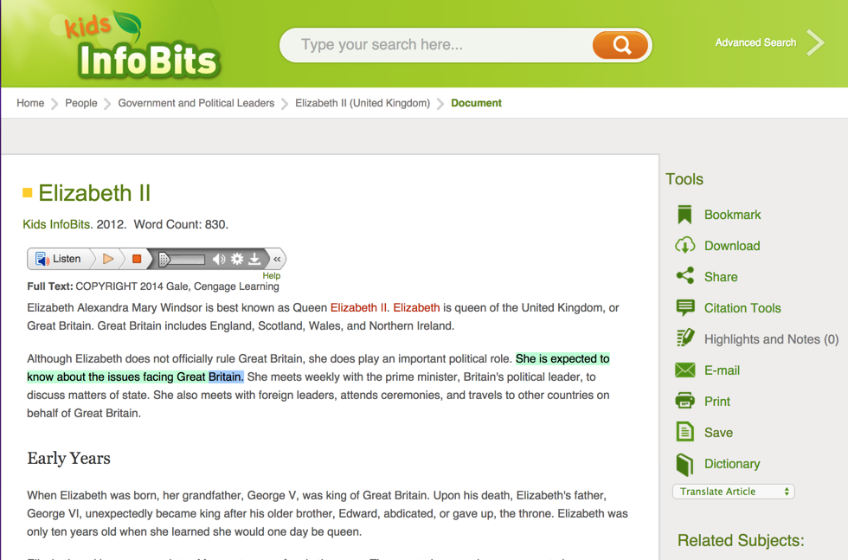
Articles Read Aloud and Highlighted

Slide 21
EQUITY
Notes:
Regardless of district size or funding, all Texas public school and public enrollment charter school educators, students, and studentsʼ families have equal access to TexQuest. If districts were to purchase these resources individually, the cost would be high and access to resources could be inequitable based on the funds available to each district. In our increasingly mobile society, students’ access to information will not be limited because of where they live.

Slide 22
Statewide Access to Quality Online Resources

Slide 23
Translations in multiple
LANGUAGES
Notes:
Most TexQuest resources can be translated into multiple languages other than English, and many translations have the read-aloud feature. Some TexQuest partners also offer databases and encyclopedias that originate in Spanish. This is an excellent resource not only for students who are fluent in another language, but also students in foreign language classes.

Slide 24
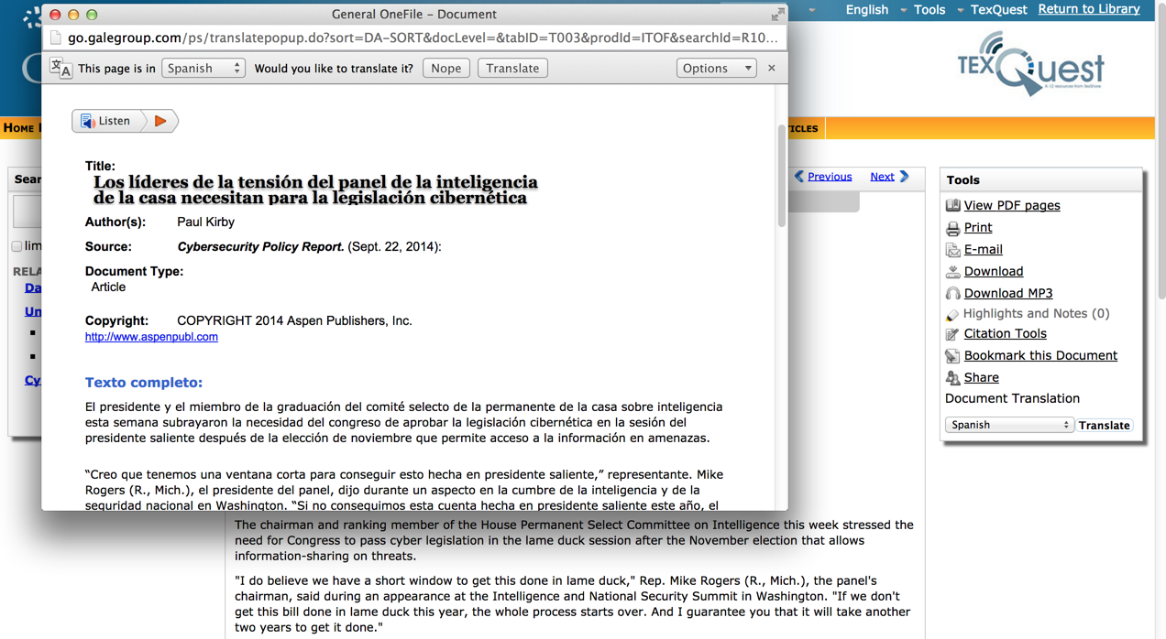
Articles Translated into 11 Languages

Slide 25
RELIABLE
resources
Notes:
Students -and teachers- can be overwhelmed with choices. TexQuest resources make it easy to narrow subjects and identify the resources needed for a project or homework. When students do an online search, they are often unaware of the format of their response. A newspaper, magazine, or reference book looks like a website to them - they are all on a computer screen. Digital resources in TexQuest make it easier for students to distinguish the type of format, its timeliness, depth, and reading level.

Slide 26
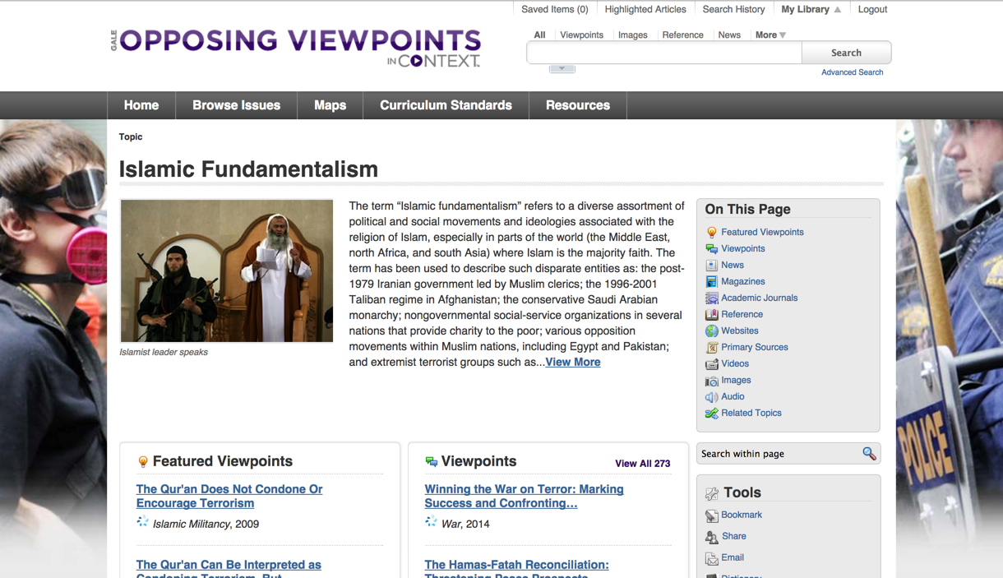
Appropriate Information - Not blocked

Slide 27
AGE APPROPRIATE
Age
APPROPRIATE
Notes:
TexQuest content give students access to school safe resources. While nothing takes the place of parental control, TexQuest gives students the ability to research controversial topics without fear of accessing inappropriate images or content. They also can access material that they need for school without the fear of triggering blocking software.

Slide 28
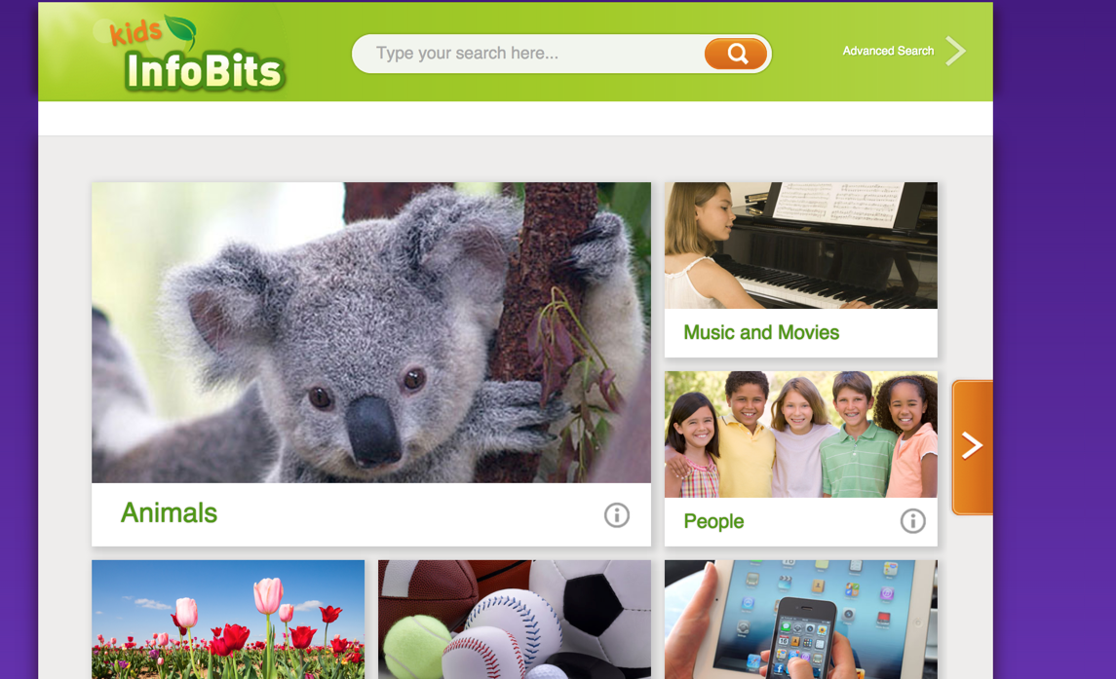
Searching Skills Build from K through 12

Slide 29
Copyright
SAFE
Notes:
Teachers and students may download, print, insert, or link to photos, audio files, and videos from TexQuest without having to worry about copyright compliance. They will still need to abide to the allowable amount of work to be quoted in projects, rewriting in their own words and citations; however, citations are provided for all resources.

Slide 30
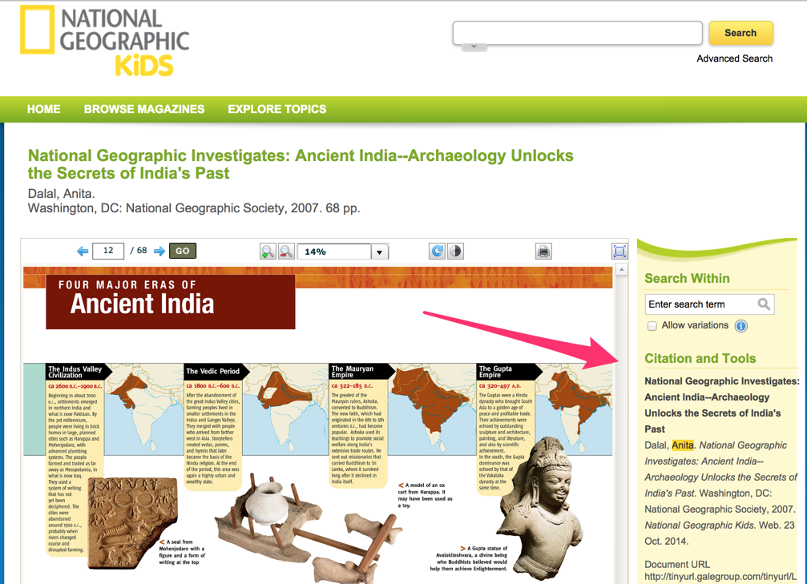
MLA Citations for All Resources

Slide 31
increased student
ACHIEVEMENT
Notes:
There is something for everyone in TexQuest - from articles on animal behavior in National Geographic Kids to literary criticism in Literature Resource Center to both sides on controversial topics in Opposing View Points in Context. And many of the resources are aligned with the Texas TEKS!
Using quality digital resources from TexQuest enables students to acquire, practice, and apply higher order thinking skills, resulting in better performance on standardized tests and better preparation for life after graduation.

Slide 32
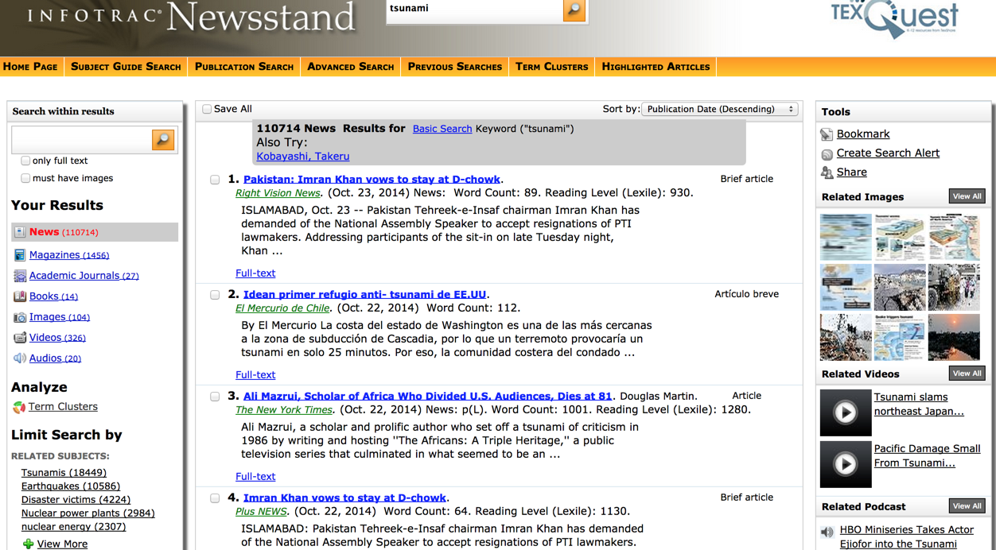
Images, Audio, & Video Files

Slide 33
Career and College
READINESS
Notes:
Research skills are not limited to searching; they are a much more complex set of lifelong skills needed to succeed in K-12 and beyond.
TexQuest allows students to investigate multiple careers and topics of personal interest. It also gives them a head start on digital content they will be expected to use in college and the workplace.

Slide 34
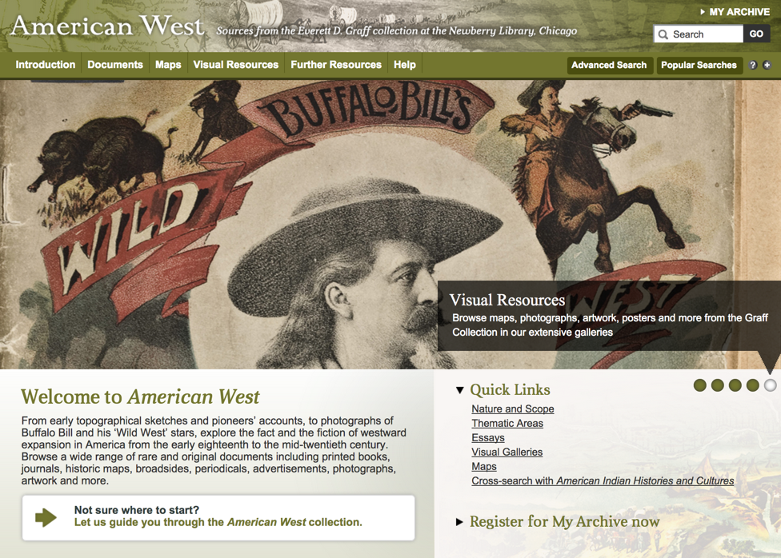
Quality Primary Resources Available

Slide 35
Current and
Enjoyable
Notes:
TexQuest gives students access to high interest educational resources. Through National Geographic Kids, they can access over 250 simultaneous use E-books, along with all back issues of National Geographic Kids magazine. TexQuest news sources are updated daily, giving your family access to current news from all over the United States and the World!

Slide 36
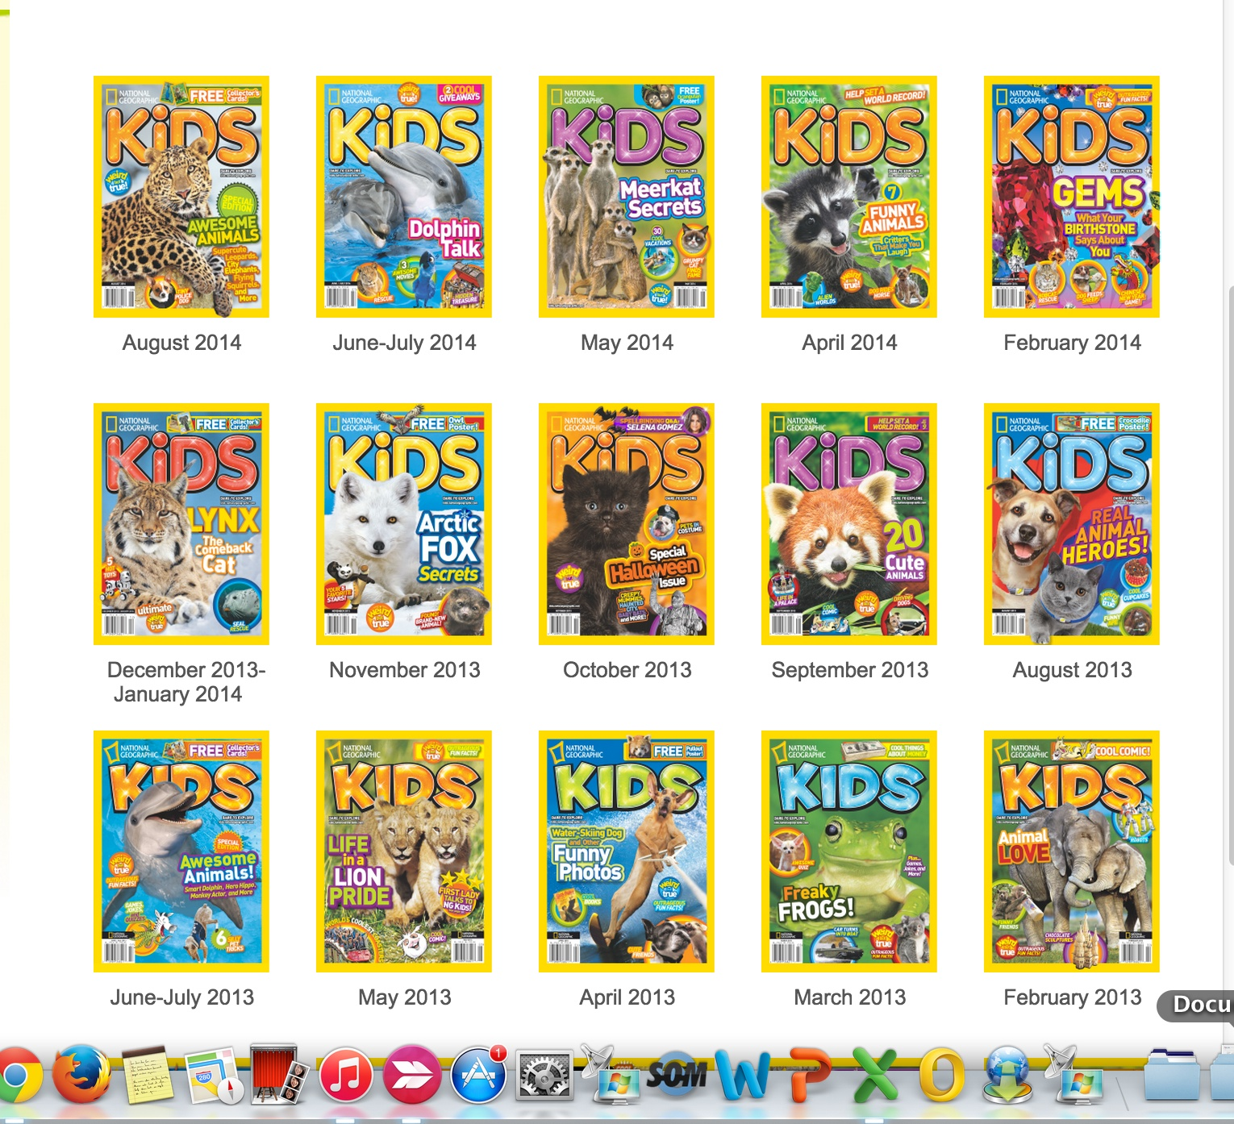
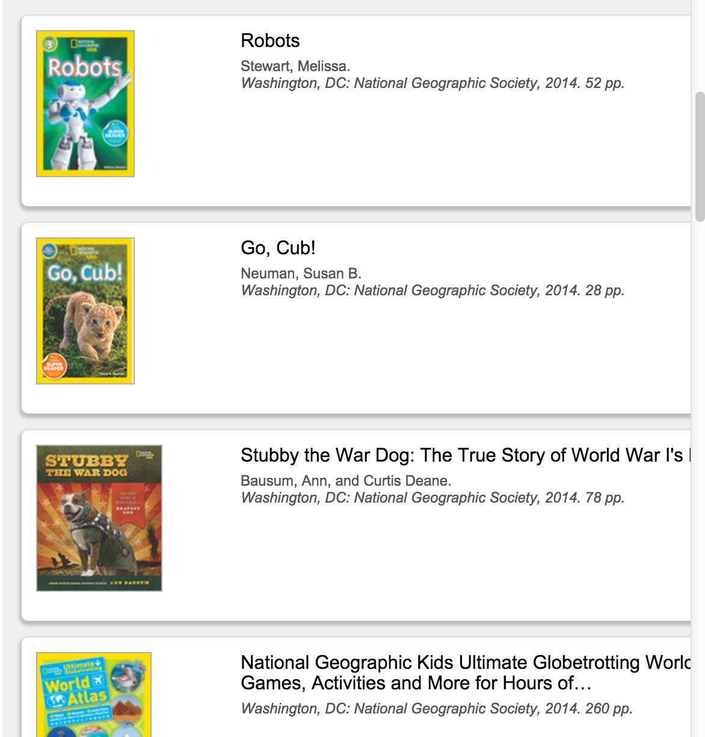
E-books and Online Magazines

Slide 37
Resources
TexQuest Resource Guide
Article for Parents

Slide 38
Other Ways Your School Library Media Center Is Open 24/7
Additional Online Resources
Links to Websites and Assignments
Online Catalog of Books - Reserve and Renew
E-book Platforms
Audio Book Connections

Slide 39
www.texquest.net
ESC-20 TexQuest Help Desk
texquest@esc20.info
844.719.1501 (toll free)
Len Bryan
School Program Coordinator
Texas State Library and Archives Commission
k12@tsl.texas.gov
512.463.5852
Ann Vyoral
Educational Specialist, Digital Resources & Library Services
Education Service Center, Region 20
ann.vyoral@esc20.net
210.370.5721
Susanna Garza
Coordinator, Digital Age Learning
Education Service Center, Region 20
susanna.garza@esc20.net
210.370.5634

